Slide 1
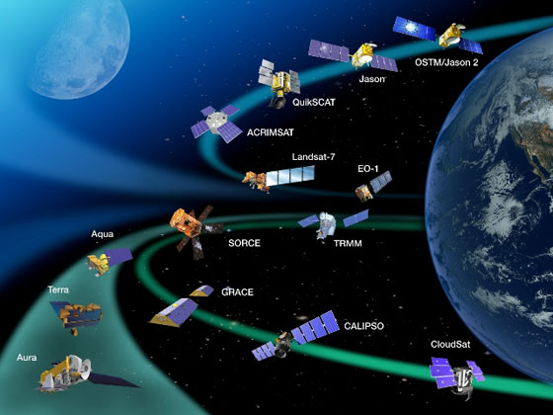
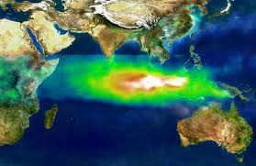

Satellite Remote Sensing of Surface Air Quality
Pawan Gupta
NASA Goddard Space Flight Center
GESTAR/USRA
ARSET
Applied Remote SEnsing Training
A project of NASA Applied Sciences
(pawan.gupta@nasa.gov)

Slide 2
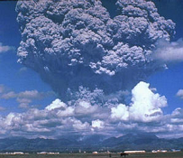
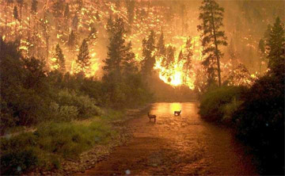
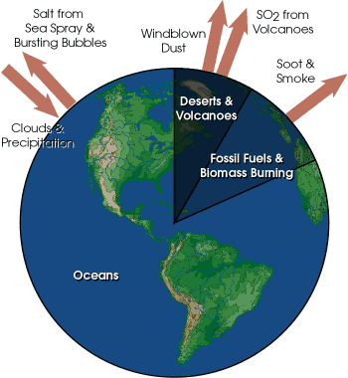
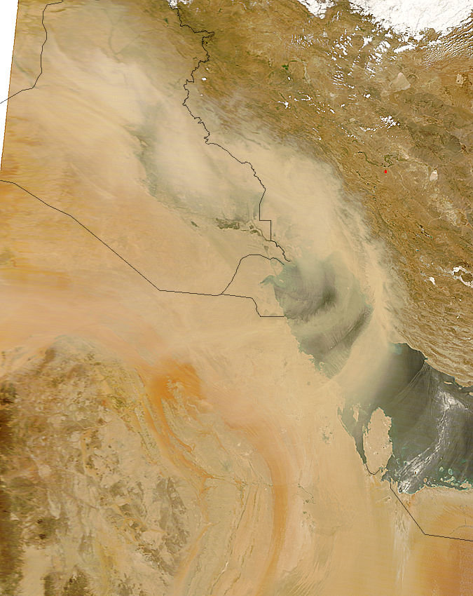
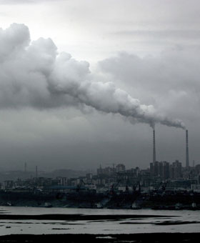
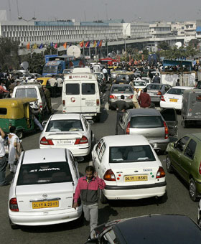
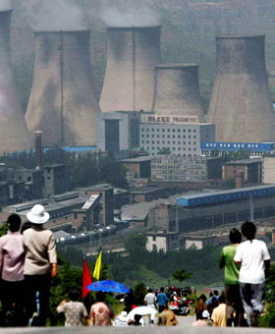
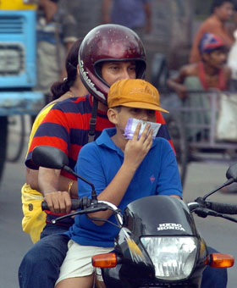

Pollution Sources
Mt. Pinatubo
Dust
Atmospheric aerosols are highly variable in space and time

Slide 3
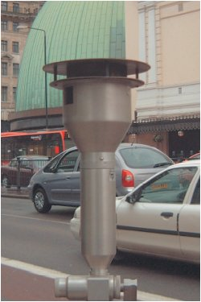
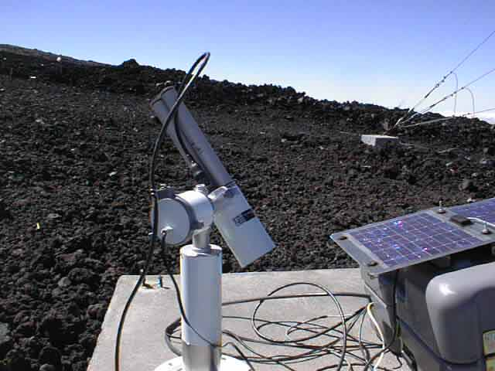
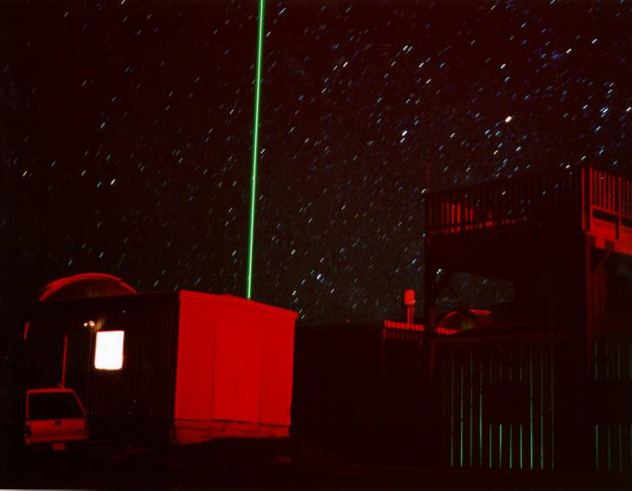

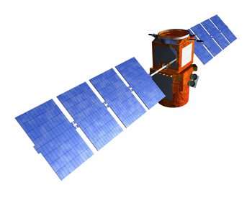
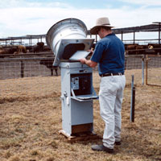
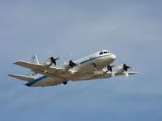
Air Pollution Monitoring
Ground Measurements
Models
Air and Space Observations

Slide 4
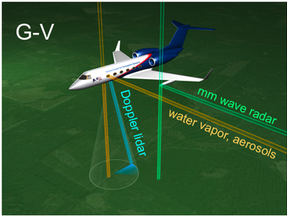
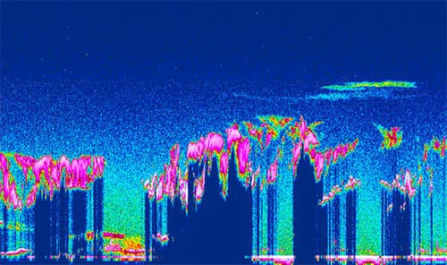
Air Pollution Monitoring
CIMEL
MODELS
Satellite
TEOM
LIDAR
Aircraft
Sampler

Slide 5
How Satellite Works?
Notes:
I will not discuss why air quality monitoring is required --- it has been discussed in great details during at this forum and I am assuming we all aware of its important for both health & climate aspects.

Slide 6


Remote Sensing
Collecting information about an object without being in direct physical contact with it.

Slide 7
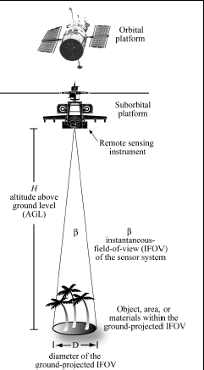
Remote Sensing …
Notes:
“the art, science, and technology of obtaining reliable information about physical objects and the environment, through the process of recording, measuring and interpreting imagery and digital representations of energy patterns derived from noncontact sensor systems”. (Cowell 1997).
A remote sensing instrument collects information about an object or phenomenon within the IFOV of the sensor system without being in direct physical contact with it. The sensor is located on a suborbital or satellite platform.

Slide 8

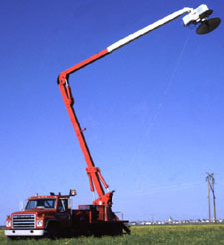
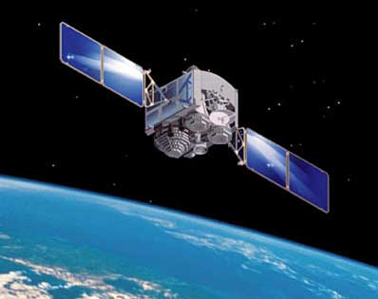
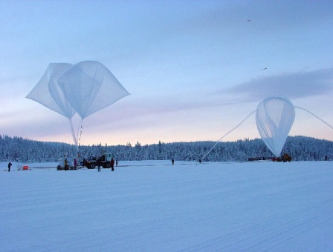
Remote Sensing: Platforms
Platform depends on application
What information do we want?
How much detail?
What type of detail?
How frequent?

Slide 9
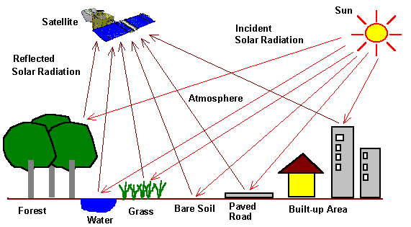
What does satellite measures ?
Reference: CCRS/CCT

Slide 10
Remote Sensing Cont…
Satellite measured spectral radiance
A priority information & Radiative Transfer Theory
Geophysical Parameters
Retrieval Algorithm
Applications

Slide 11
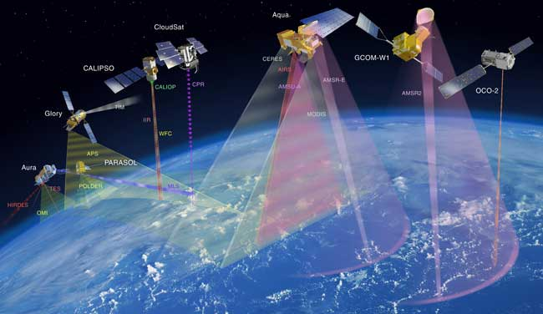
Number of Satellites making daily observations of Earth-Atmosphere and Ocean Globally

Slide 12
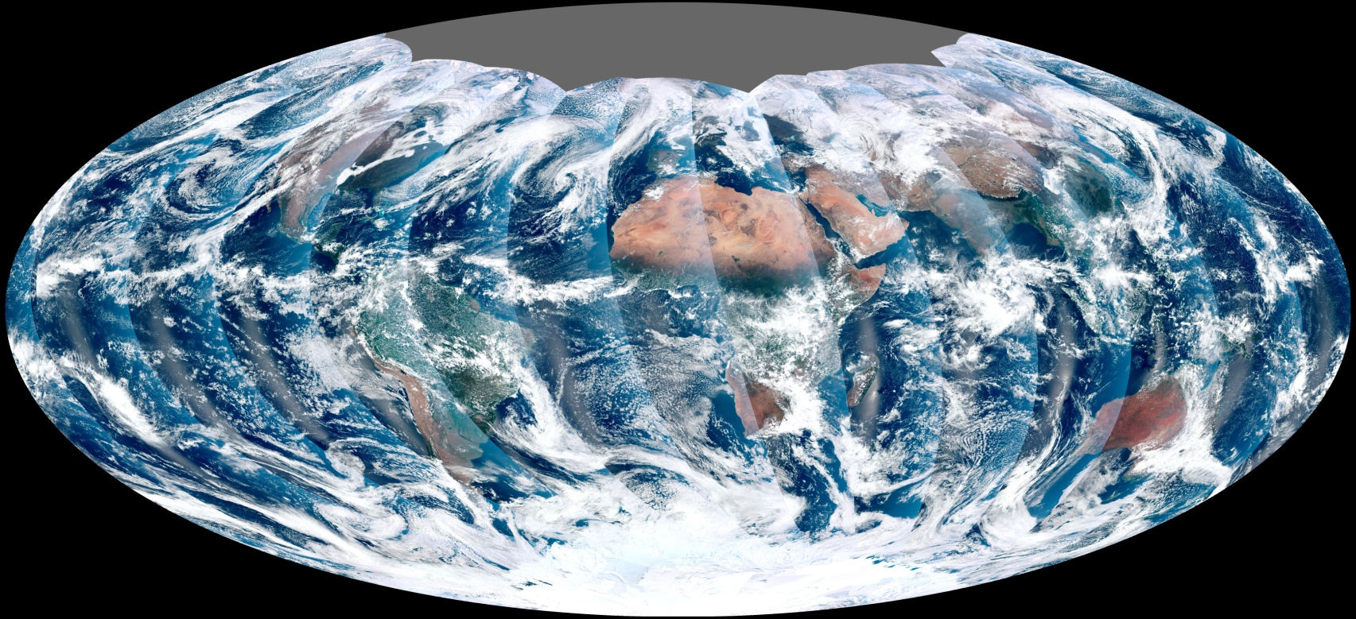
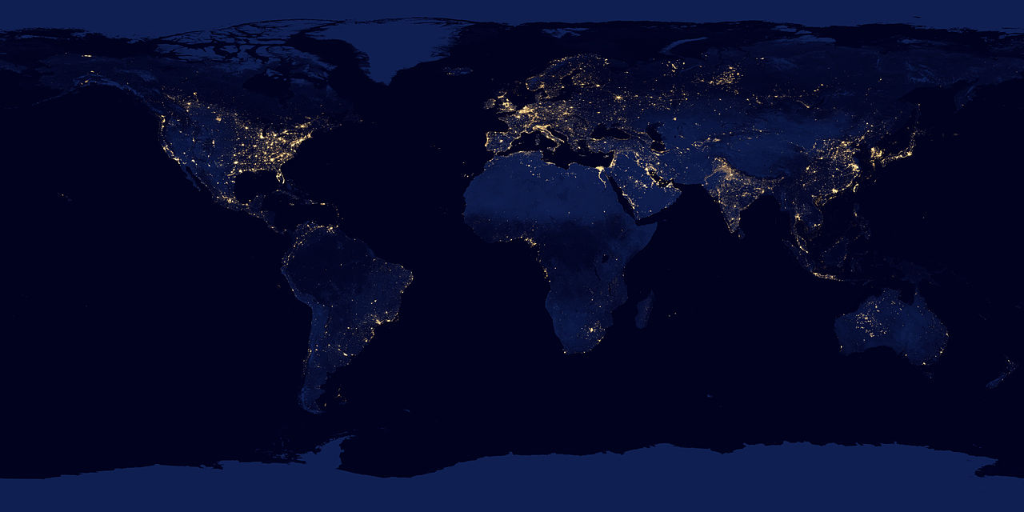
VIIRS
Day Time
What you get from satellite ?
Night Time

Slide 13
Why Satellites for Air Quality Monitoring ?
Notes:
I will not discuss why air quality monitoring is required --- it has been discussed in great details during at this forum and I am assuming we all aware of its important for both health & climate aspects.

Slide 14
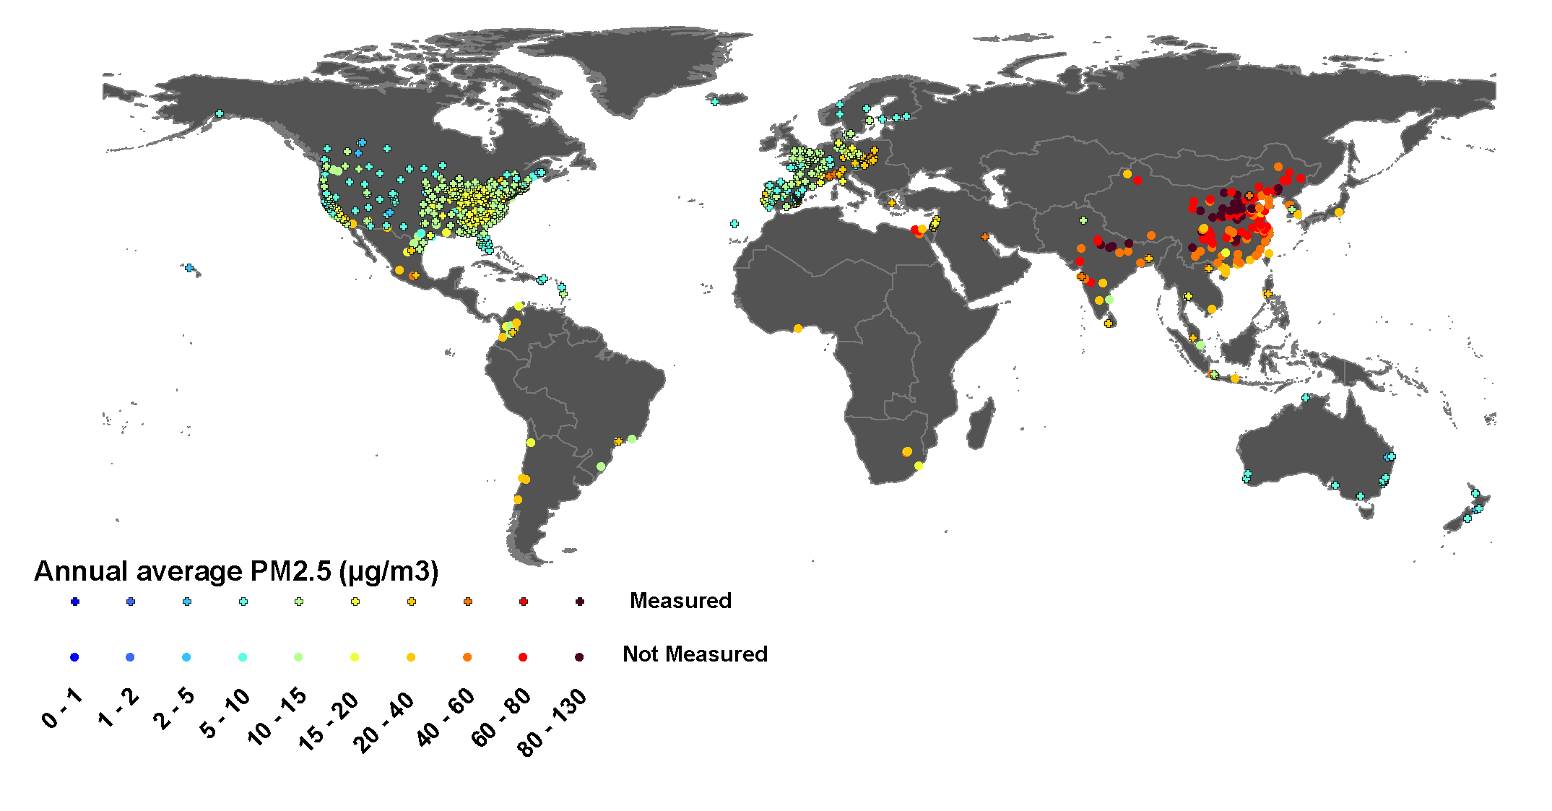
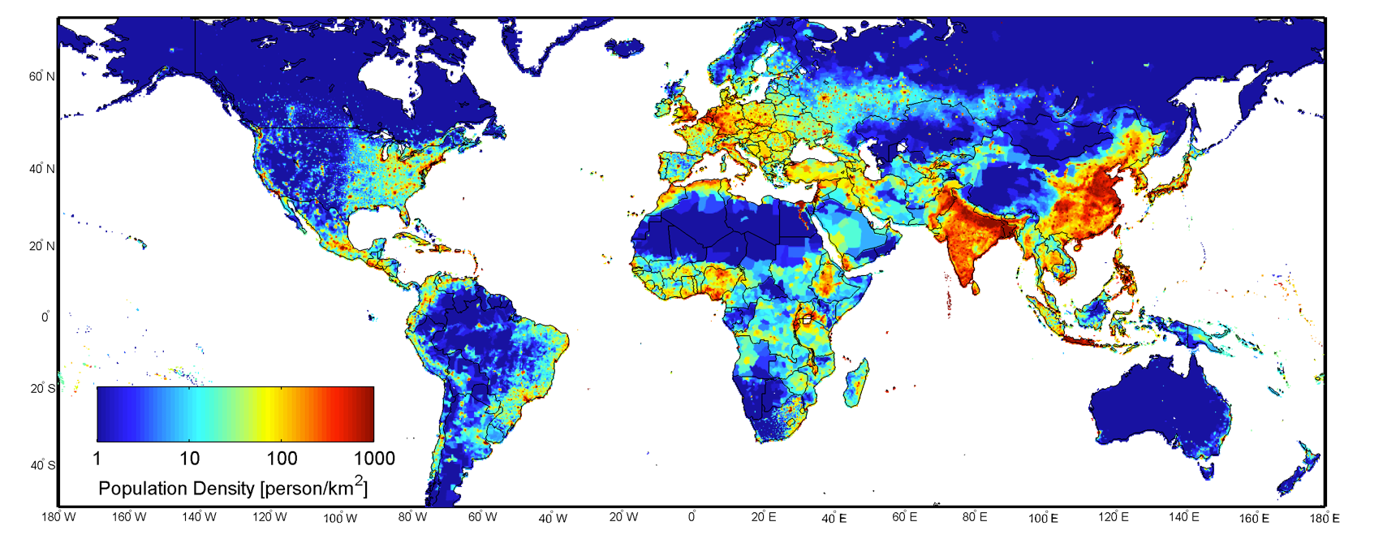
Global Status of PM2.5 Monitoring
Ground Sensor Network
Not complete network but representative
Population Density
Notes:
Ground sensors give us by far the most accurate measurements of ground level pollutants. The ground sensor networks (not a complete list of all ground stations globally) are indicated by the colored dots on the upper image. The image on the lower right shows population density. You can see that several areas of the globe with significant populations have almost no monitors at all. In addition most of the sensors in India and China are measuring calculating PM 2.5 from PM 10 measurements. One important thing to note is that even in the U.S., the most completely instrumented country in the world, 2400 out of 3100 counties (31% of total population) have no PM monitoring.

Slide 15
Global Status of PM2.5 Monitoring
Spatial distribution of air pollution from existing ground network does not support high population density.
Surface measurements are not cost effective
Many countries do not have PM2.5 mass measurements
In the US, 31% of total population have no PM monitoring.
Can be use satellites?
Notes:
Ground sensors give us by far the most accurate measurements of ground level pollutants. The ground sensor networks (not a complete list of all ground stations globally) are indicated by the colored dots on the upper image. The image on the lower right shows population density. You can see that several areas of the globe with significant populations have almost no monitors at all. In addition most of the sensors in India and China are measuring calculating PM 2.5 from PM 10 measurements. One important thing to note is that even in the U.S., the most completely instrumented country in the world, 2400 out of 3100 counties (31% of total population) have no PM monitoring.

Slide 16
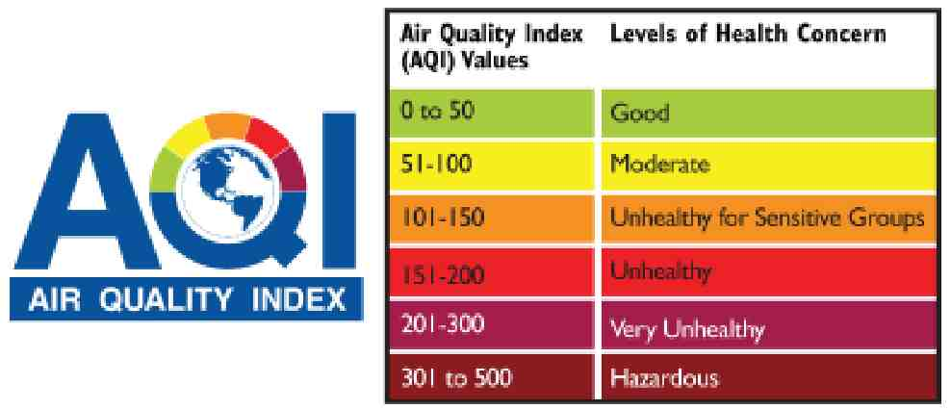
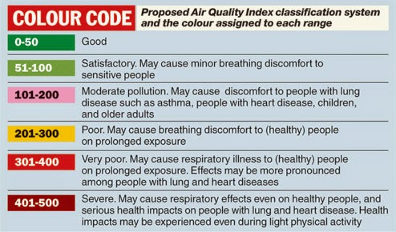
Environmental Agencies & Public Looking for…
WHO
India
40 µgm⁻³ – Annual mean
60 µgm⁻³ – 24 hour mean
Public
Decision/Policy Makers
Media
Researchers

Slide 17
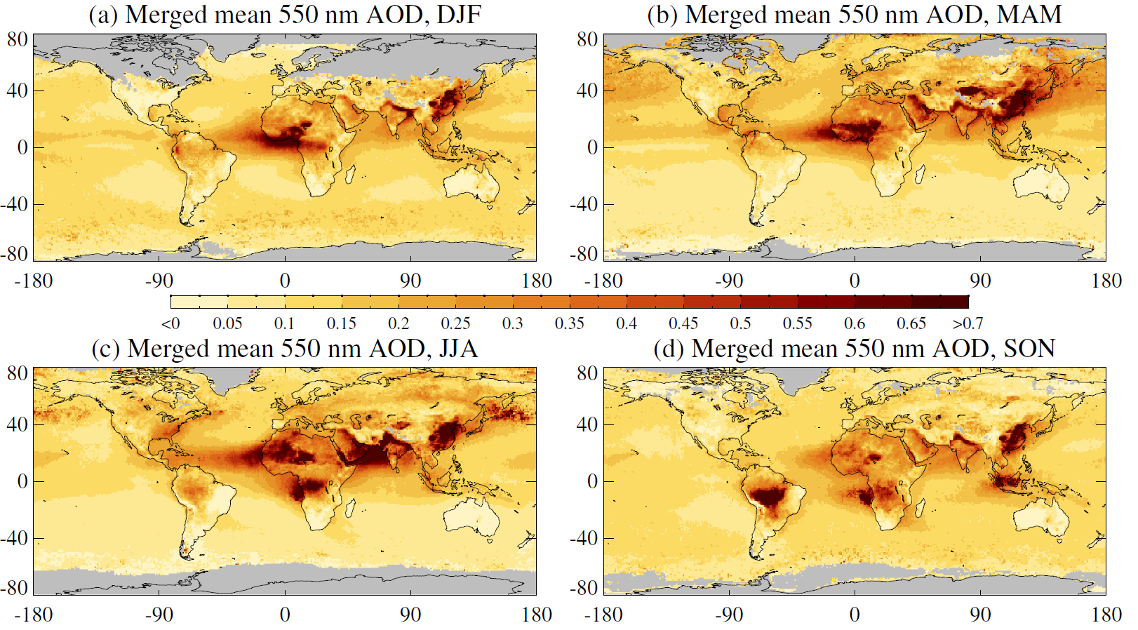
Aerosols from satellite
Biomass Burning
Aerosol Optical Thickness MODIS AQUA
Winter
Spring
Pollution & dust
Summer
Fall
Haze & Pollution
Biomass Burning
Dust
Several satellites provide state-of-art aerosol measurements over global region on daily basis
Notes:
There are many satellites capable of global and partial global measurements each day. Here you can see visually the product call AOD (Aerosol Optical Depth) which is an optical measurement of total column aerosol.

Slide 18


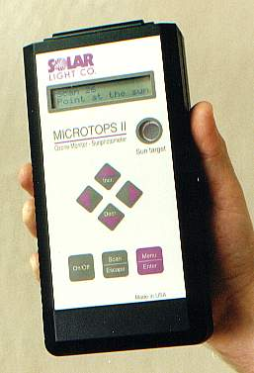
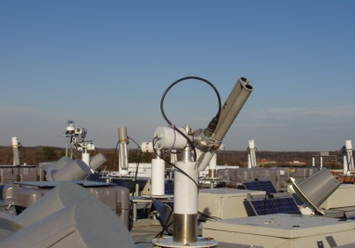
Aerosol Optical Depth
Sun
The optical depth expresses the quantity of light removed from a beam by scattering or absorption by aerosols during its path through the atmosphere
Atmosphere
These optical measurements of light extinction are used to represent aerosols (particulate) amount in the entire column of the atmosphere.
AOD - Aerosol Optical Depth
AOT - Aerosol Optical Thickness
Surface

Slide 19
Aerosol Optical Depth to Surface Particulate Matter

Slide 20
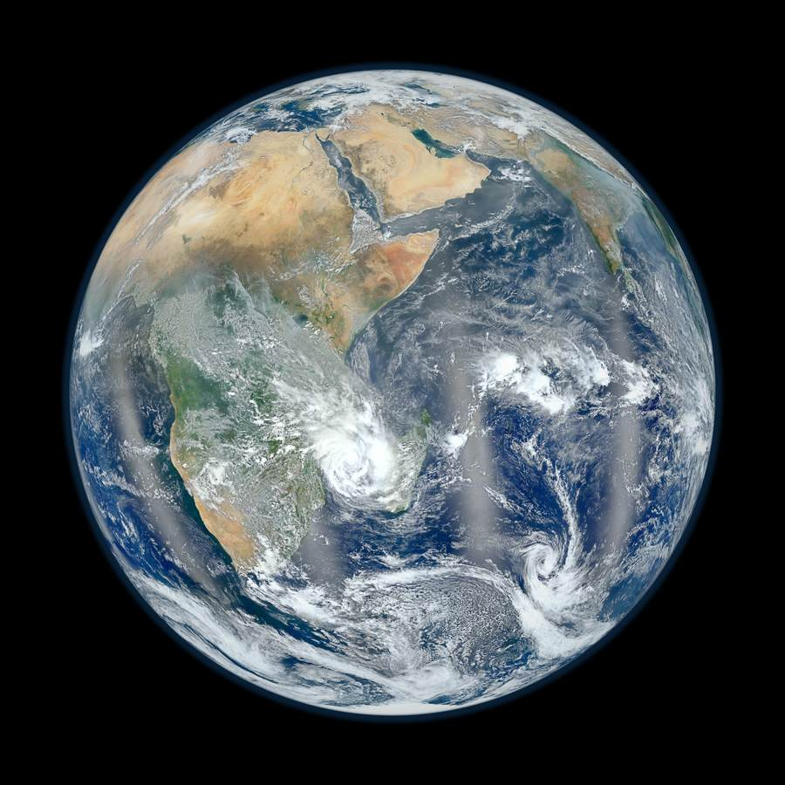
What is our interest and what we get from satellite?
To of the Atmosphere
10 km² Vertical Column
Aerosol Optical Depth
Particle size Composition Water uptake Vertical Distribution
Surface Layer
Earth Surface
PM2.5 mass concentration (µgm⁻³) -- Dry Mass

Slide 21
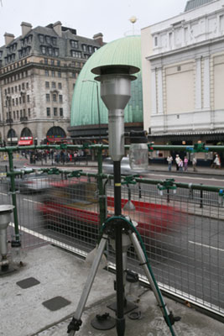
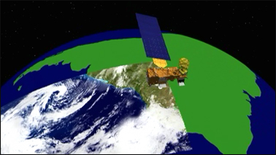
AOD vs PM2.5
AOD – Column integrated value (top of the atmosphere to surface) - Optical measurement of aerosol loading – unit less. AOD is function of shape, size, type and number concentration of aerosols
PM2.5 – Mass per unit volume of aerosol particles less than 2.5 µm in aerodynamic diameter at surface (measurement height) level

Slide 22
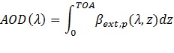
AOD – PM Relation
Top-of-Atmosphere
surface
ρ – particle density
Q – extinction coefficient
r_{e} – effective radius
f_{PBL} – % AOD in PBL
H_{PBL} – mixing height
Composition
Size distribution
Vertical profile

Slide 23
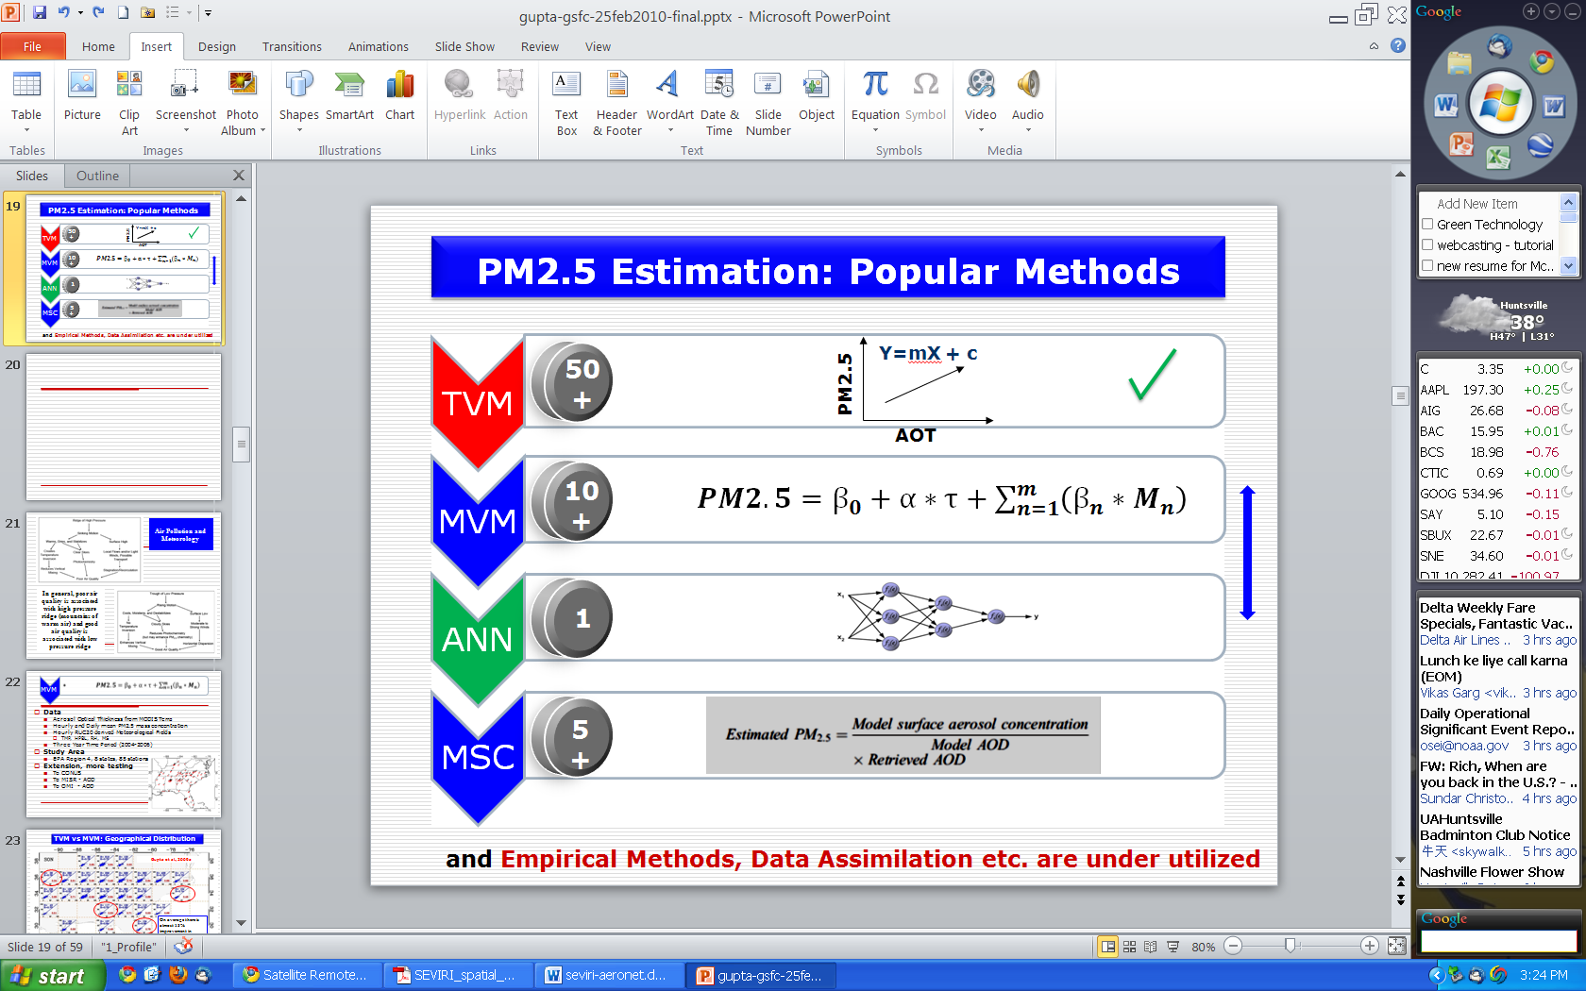
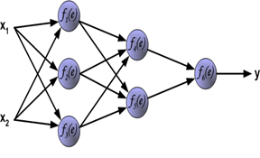
PM2.5 Estimation: Popular Methods
Difficulty Level
Two Variable Method
Multi-Variable Method
Artificial Neural Network
MSC
Y=mX + c
PM2.5
AOT
and Empirical Methods, Data Assimilation etc. are under utilized

Slide 24
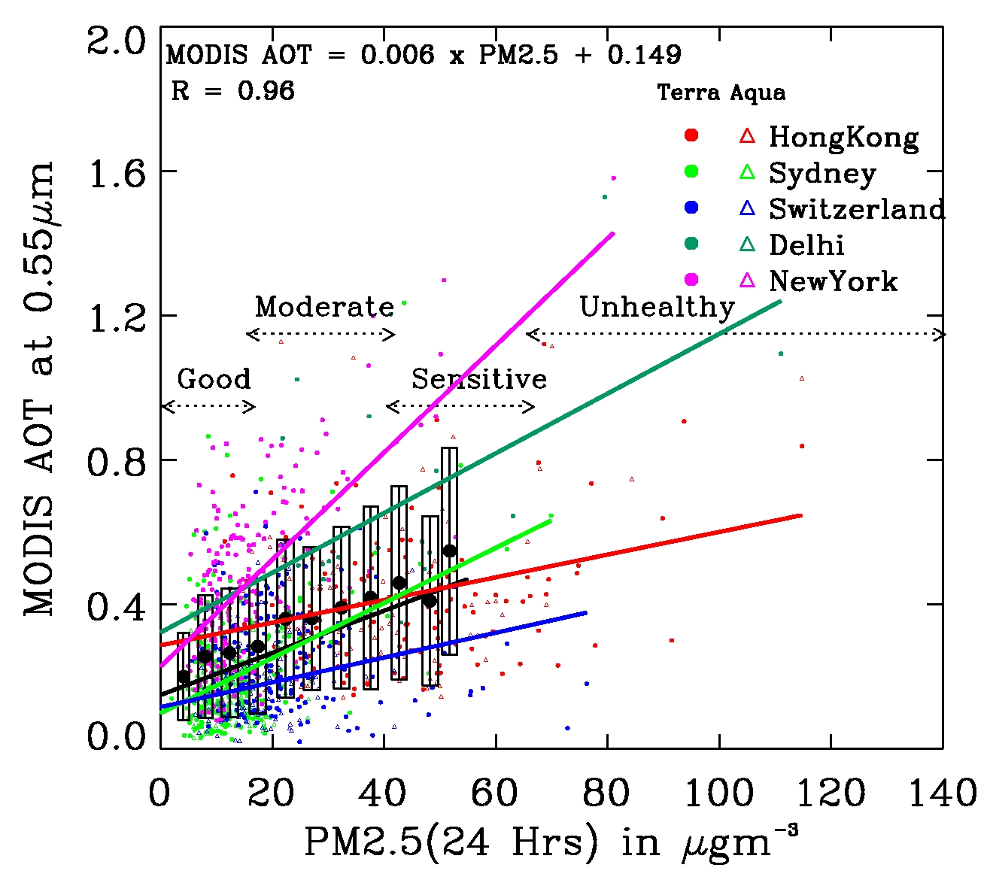
AOD & PM2.5 Relationship
Gupta et al., 2006

Slide 25
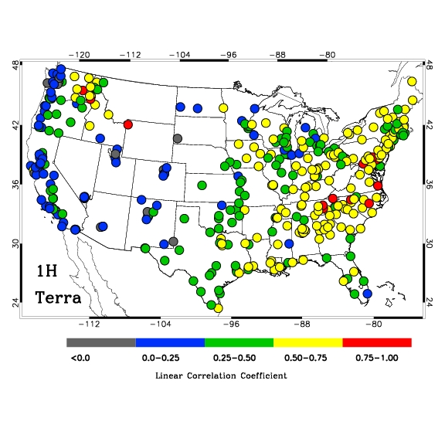
AOT-PM2.5 Relationship
Gupta, 2008

Slide 26
PM2.5 Estimation: Popular Methods
Difficulty Level
Two Variable Method
Multi-Variable Method
Artificial Neural Network
MSC
Y=mX + c
PM2.5
AOT
and Empirical Methods, Data Assimilation etc. are under utilized

Slide 27
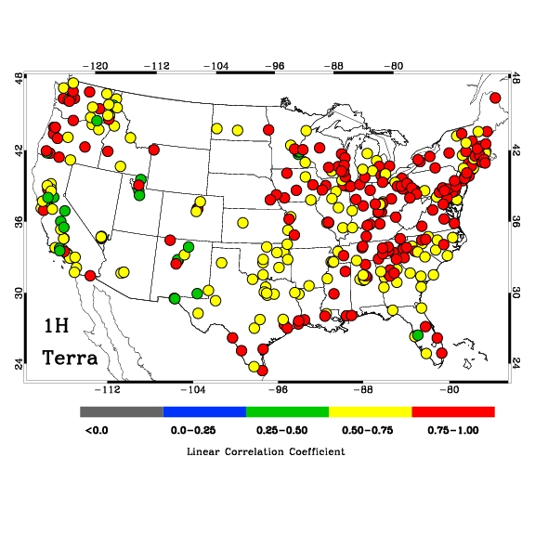
Advantages of using reanalysis meteorology along with satellite
Predictor: AOD
Predictor: AOD + Meteorology
TVM
Linear Correlation Coefficient between observed and estimated PM2.5
Gupta, 2008

Slide 28
PM2.5 Estimation: Popular Methods
Difficulty Level
Two Variable Method
Multi-Variable Method
Artificial Neural Network
MSC
Y=mX + c
PM2.5
AOT
and Empirical Methods, Data Assimilation etc. are under utilized

Slide 29
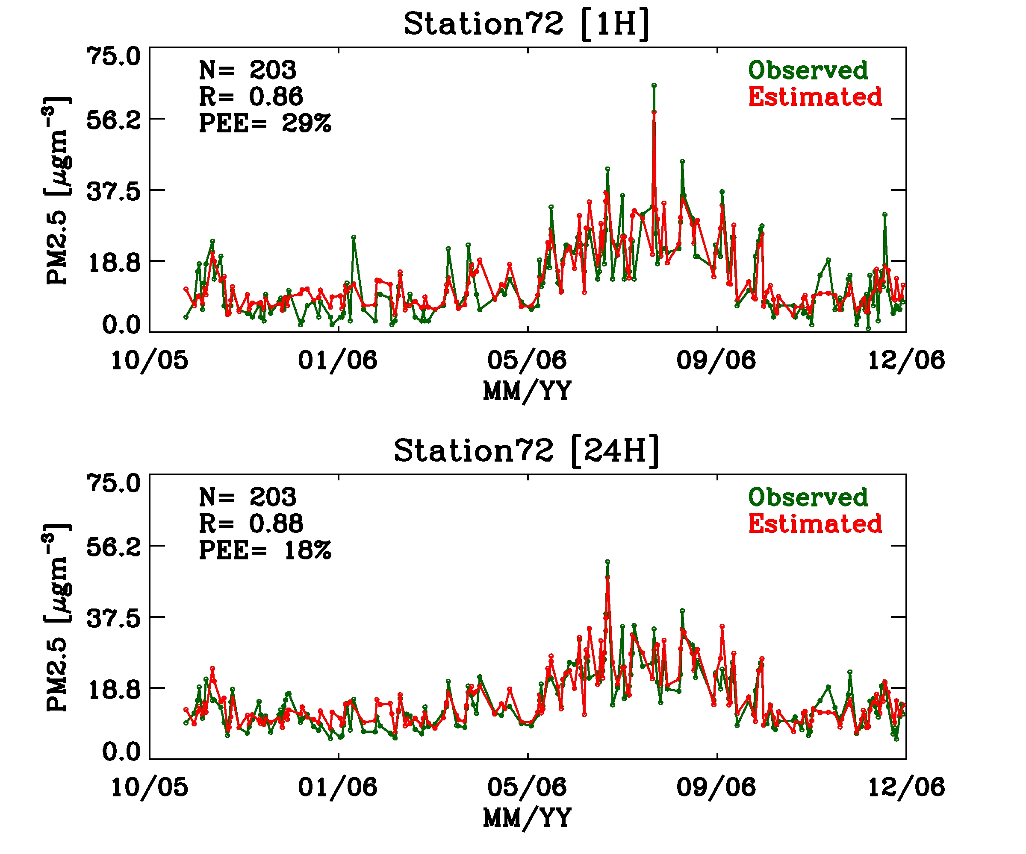
Time Series Examples of Results from ANN
Gupta et al., 2009

Slide 30
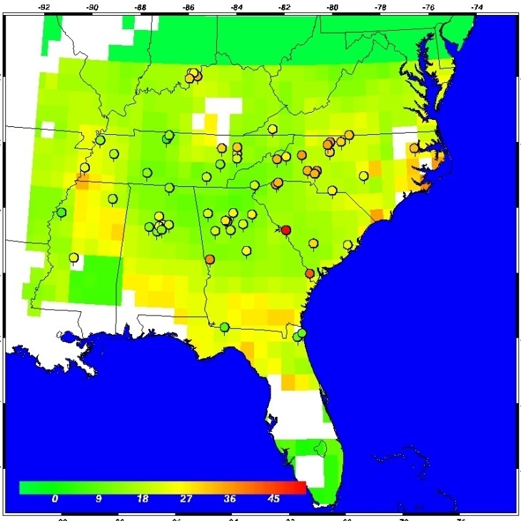
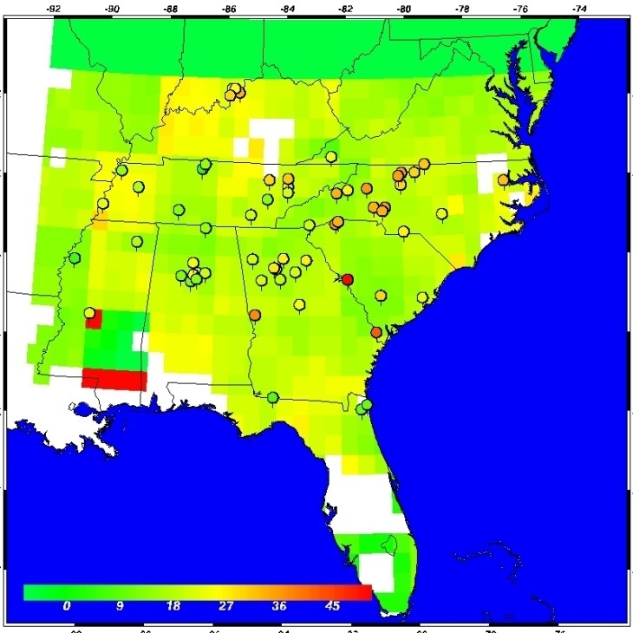
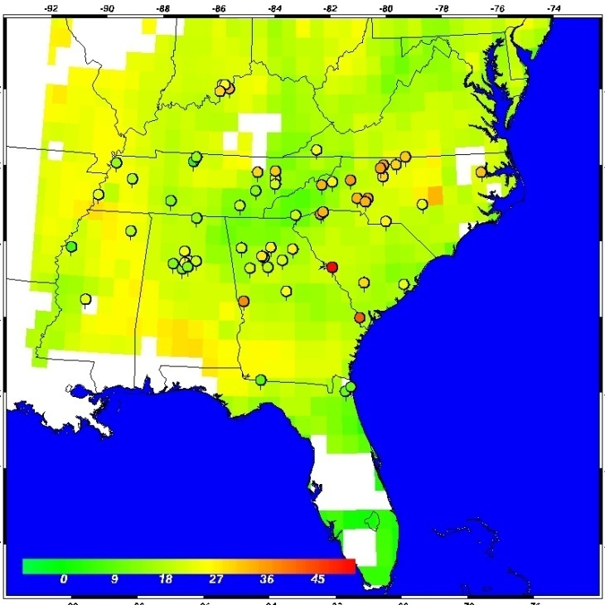
TVM
Vs
MVM
vs
Artificial Intelligence
TVM
MVM
ANN
Gupta et al., 2009

Slide 31
PM2.5 Estimation: Popular Methods
Difficulty Level
Two Variable Method
Multi-Variable Method
Artificial Neural Network
MSC
Y=mX + c
PM2.5
AOT
and Empirical Methods, Data Assimilation etc. are under utilized

Slide 32
Scaling approach
Basic idea: let an atmospheric chemistry model decide the conversion from AOD to PM_{2.5}. Satellite AOD is used to calibrate the absolute value of the model-generated conversion ratio.
Satellite-derived PM_{2.5} =
x satellite AOD
Liu et al., 2006,

Slide 33
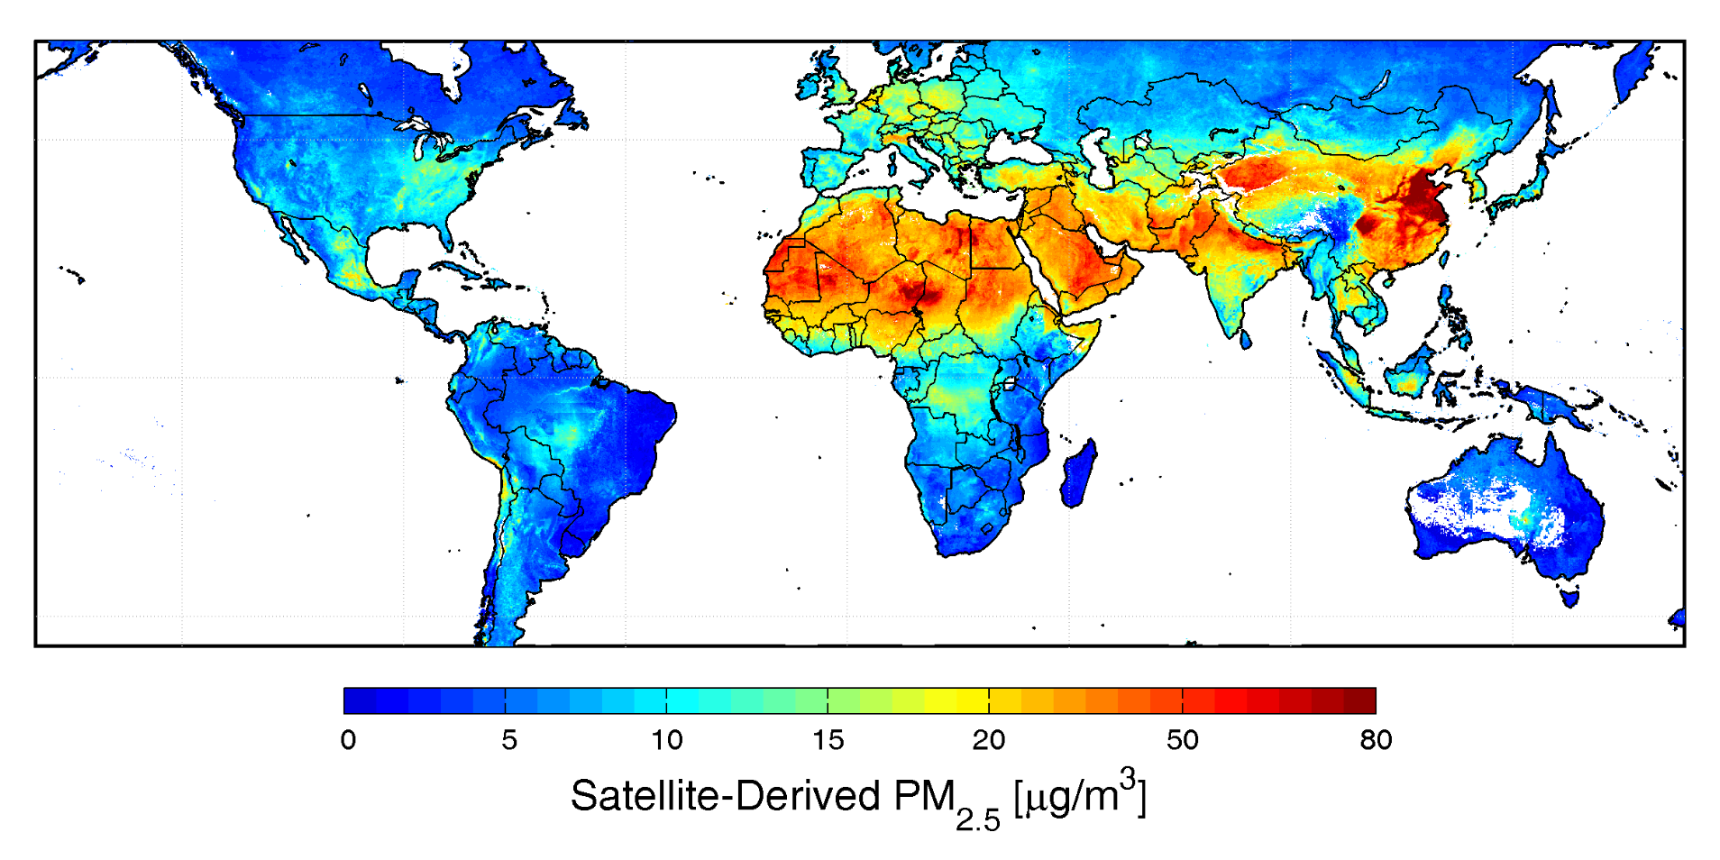
Annual Mean PM2.5 from Satellite Observations
van Donkelaar et al., 2006, 2009

Slide 34
Questions to Ask: Issues
How accurate are these estimates ?
Is the PM2.5-AOD relationship always linear?
How does AOD retrieval uncertainty affect estimation of air quality
Does this relationship change in space and time?
Does this relationship change with aerosol type?
How does meteorology drive this relationship?
How does vertical distribution of aerosols in the atmosphere affect these estimates?

Slide 35
The Use of Satellite Models
Currently for research
Spatial trends of PM_{2.5} at regional to national level
Interannual variability of PM_{2.5}
Model calibration / validation
Exposure assessment for health effect studies
In the near future for research
Spatial trends at urban scale
Improved coverage and accuracy
Fused statistical – deterministic models
For regulation?

Slide 36
Trade-offs and Limitations
Spatial resolution – varies from sensor to sensor and parameter to parameter
Temporal resolution – depends on satellite orbits (polar vs geostationary), swath width etc.
Retrieval accuracies – varies with sensors and regions
Calibration
Data Format, Data version
Etc.

Slide 37
Assumption for Quantitative Analysis
When most particles are concentrated and well mixed in the boundary layer, satellite AOD contains a strong signal of ground-level particle concentrations.
No textbook solution!

Slide 38
Shopping List - Requirements for this job
A good high speed computer system
Internet to access satellite & other data
Some statistical software (SAS, R, Matlab, etc., IDL, Fortran, Python, etc.)
Some programming skill
Knowledge of regional air pollution patterns
Ideally, GIS software and working knowledge
Surface & Satellite Data

Slide 39
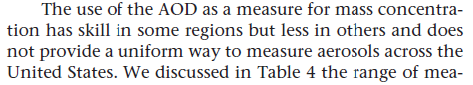
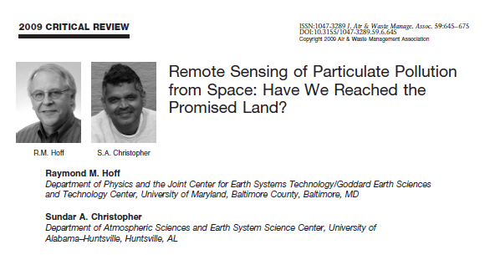
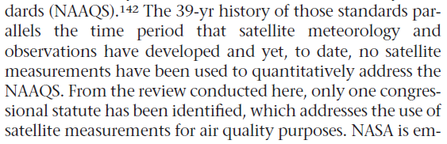




Suggested Reading

